Slide 1
Proxy

Slide 2
AGENDA
Why Proxy’s ?
What is the use of proxy’s ?
How it can be created and used ?

Slide 3
Why Proxy’s ?
We can integrate SAP system with PI with below three different adapters:
RFC
IDoc
Proxy

Slide 4
Advantages of ABAP Proxies:
Proxy communication always by passes the Adapter Engine and will directly interact with the application system and Integration engine. So it will give us better performance.
Proxies communicate with the XI server by means of native SOAP calls over HTTP.
Easy to handle messages with ABAP programming.
Proxy is good for large volumes of data. we can catch and persist the errors ( both system & application fault ) which was generated by Proxy setting.

Slide 5
There are 2 types of proxies available.
1. Java Proxies
2. ABAP Proxies.
Java Proxies: - Java proxies are used when JAVA applications needs to send or receive messages with other applications. JAVA proxies are generated from the WSDL description of the interface in the Integration Repository, and the result is a .jar file containing generated java classes corresponding to the integration objects.
2. ABAP Proxies: - ABAP proxies are used when ABAP applications needs to send or
receive messages. ABAP proxies are generated on the Application server with transaction SPROXY, based on the WSDL representation of the message interface.

Slide 6
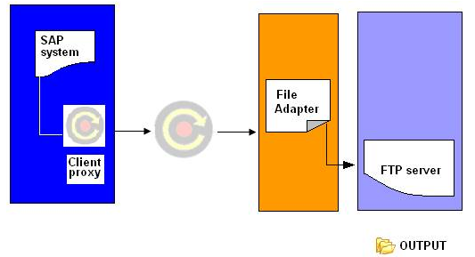
There are two type of ABAP proxy’s
Client proxy/Outbound proxy
Server proxy/Inbound proxy
Client proxy/Outbound proxy :

Slide 7
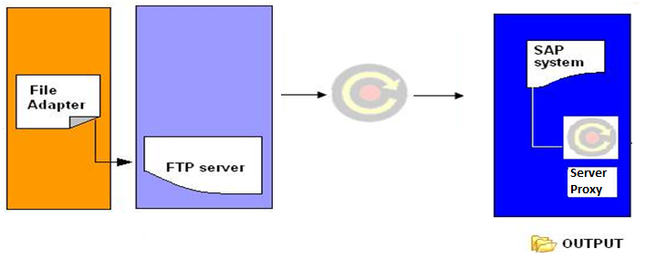
Server proxy/Inbound proxy

Slide 8
Steps required for developing ABAP Proxies in dual stack :
Create a source data type and a target data type.
Create Message types for the source and target data types.
Create Message Interfaces includes Inbound Message interface and Outbound
Message interface.
Create message mapping between the source and target message types.
Create Interface mapping.
Create ABAP proxies using the transaction SPROXY in the application system.
Creating ABAP Proxies in Application system
Go to SPROXY transaction in R/3 system.
Here we can see all the Integration Repository objects. Select the outbound interface for which we want to create the proxy. Right click on the interface and select create option.

Slide 9
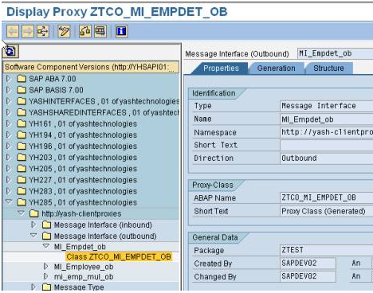
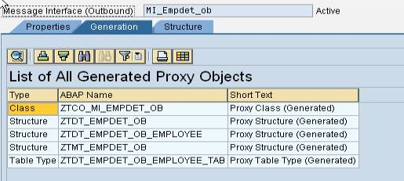
SPROXY screen shot in ECC system
ABAP proxy will generate the following objects.

Slide 10
Steps required for developing ABAP Proxies in single stack :
Create a source data type and a target data type.
Create Message types for the source and target data types.
Create Message Interfaces includes Inbound Message interface and Outbound Message interface.
Create message mapping between the source and target message types.
Create Interface mapping.
Create ABAP proxies using the transaction SPROXY in the application system.
Creating ABAP Proxies in Application system:
Go to SPROXY transaction in R/3 system.
Here we can see all the Integration Repository objects. Select the outbound interface for which we want to create the proxy. Right click on the interface and select create option.

Slide 11
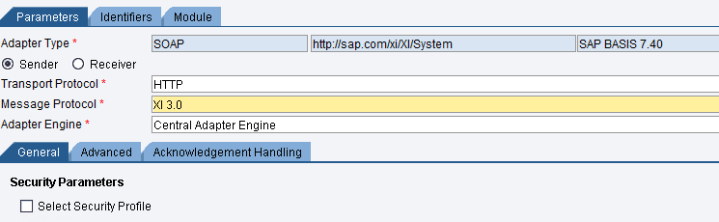
Objects that need to be developed in ID :
Create sender and receiver communication component
Create sender and receiver communication channels
Create Integrated Configuration.
In sender communication channel we should select Adapter type is SOAP Adapter
Transport Protocol : HTTP
Message Protocol : XI3.0

Slide 12
Thanks You
QUESTION ????

